Slide 1
Video 10 - Data collection
Steve Simon

Slide 2
Data collection methods
Data collection methods
Focus groups
Interviews
Questionnaires
Standardized instruments
Existing data
Data quality
Notes:
The first half of this talk will cover various data collection methods. The second half will cover data quality issues.

Slide 3
Running focus groups
Two person job
Facilitator
Asks questions
Guide discussion, but stays neutral
Recorder
Runs the tape recorder
Keeps written notes
Debriefing session
Notes:
If you decide to collect data in a focus group, you need a second person. You could do it by yourself, but you are asking for trouble. One of you takes the role of the facilitator and one takes the role of the recorder.
The facilitator asks a series of prepared questions. Your role is to guide the discussion while still keeping neutral. This means that you intervene if the group is getting off target or if one person is dominating the discussion. You should prepare some brief prompts to get your participants to elaborate or to draw in other participants.
The recorder doesn’t say anything after the introductions, but runs the recording device and take notes. The notes serve several purposes. First, they serve as a backup if your recording fails. Second, they note any significant non-verbal information such as gestures and body language. Third, the notes help to identify who is speaking when. A seating diagram is helpful for this. Note that not all focus groups track who is speaking.
After the session is complete, the two of you sit down and talk about how things went.

Slide 4
Structure of a focus group
Six to ten participants
Multiple groups
Stop when you achieve saturation
Sixty to ninety minutes
Ten questions, semi-structured interview
Notes:
The size of a focus group can vary, but I’ve seen recommendations of six to twelve people.
What the research community does agree on is that you need to plan for more than one group. The consistency of responses from one group to the next will tell you if you have reached saturation.
Saturation is evidence that no new themes or ideas have emerged from your groups. Almost all assessments of whether saturation has been achieved are qualitative and subjective.
The concept of saturation makes it difficult for you to plan a budget, but keep in mind that you cannot even begin to assess saturation until you’ve run your second focus group.
Other common recommendations are to keep each session short, 60 to 90 minutes, and to have no more than ten questions. Your questions should follow a semi-structured format, which I’ll talk about in the context of interviewing.
Getting information from a group is a double-edged sword. Often in a focus group, one participant will build on the comments of another and provide a perspective that you may have missed in a single person interview. At other times, however, one person may stifle the feedback from another. A good focus group leader will recognize this and work to insure that everyone participates fully. It’s easy to say this in theory, but in practice, it can be difficult.

Slide 5
Interview
Administration
Telephone
Face-to-face
Format
Unstructured
Semi-structured
Structured
Notes:
An interview is direct communication between the researcher and the subject. You can set up the interview on the telephone or conduct a face-to-face interview. The obvious advantage of a telephone interview is that it is fast and does not involve travel of either party.
A face-to-face interview takes more effort, but can sometimes help with building a sense of rapport and trust.
Interviews have three formats, unstructured, semi-structured, or structured. An unstructured format is rarely used in research because it makes you work impossible to replicate.
An unstructured interview is not used too often, because of problems with repeatability. The interviewer goes in with a general idea of what to discuss, but no specific questions. The general direction of the interview will determine what questions to ask next.
A semi-structured interview has a planned structure that includes a list of questions to ask. These questions are typically open-ended, to allow the patient to bring up issues that the researcher may not have been aware of. Most semi-structured interviews have a series of probe questions that are intended to prompt the research subject to elaborate further on a topic of interest.

Slide 6
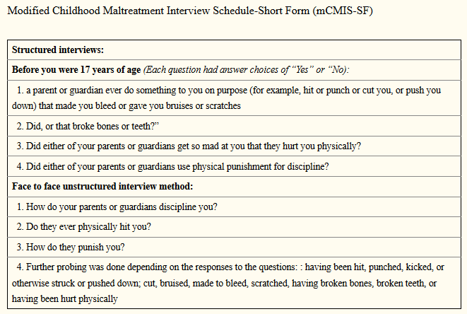
Example of structured and unstructured interviews
Description of interview for child abuse
Notes:
Here’s an example of two interviews. The first is a structured interview with four yes/no questions.
Before you were 17 years of age (Each question had answer choices of “Yes” or “No):
a parent or guardian ever do something to you on purpose (for example, hit or punch or cut you, or push you down) that made you bleed or gave you bruises or scratches.
Did, or that broke bones or teeth?”
Did either of your parents or guardians get so mad at you that they hurt you physically?
Did either of your parents or guardians use physical punishment for discipline?
The second interview is described as unstructured. I would call it semi-structured, but that is a nitpick. The questions were
How do your parents or guardians discipline you?
Do they ever physically hit you?
How do they punish you?
Further probing was done depending on the responses to the questions: : having been hit, punched, kicked, or otherwise struck or pushed down; cut, bruised, made to bleed, scratched, having broken bones, broken teeth, or having been hurt physically
The questions in the structured interview are close-ended. This is quite common, but you can also have a structured interview with open ended questions. For the semi-structured or unstructured interview, however, the questions must be open ended so that you can probe for more information.
The article that these interview questions came from noted that the unstructured interview was far more likely to uncover reports of abus than the structured interview.
Image source: Diaz 2017 (see the reading list for full details).

Slide 7
Take a break here
What have we covered
Focus groups
Interviews
What is coming next
Questionnaires

Slide 8
Questionnaire
Not the same as a survey
Questionnaire is the form
Survey is the process
Administration
Mail
Computer (REDCap)
Telephone
In person
Note: telephone and in person questionnaires could be classified as interviews.
Notes:
A questionnaire is a form with questions that your research subjects fill out by themselves. The term “quesitonnaire” is often used interchangably with the word “survey,” but there is a distinction. The questionnaire is a specific term referring to the form itself, while a survey is intended to describe the entire process of data collection.
Now I myself use these terms without regard to the semantics, so if you do so also, you are in good company. But once in a while you will find someone who insists on careful choices of words like this. These people are the same busy-bodies who insist that data is a plural noun.
You can send out a questionnaire by mail or you can ask people to fill out the questionnaire on the computer. If you are using the computer, you should consider REDCap instead of commercial products like SurveyMonkey or SurveyGizmo. REDCap is an open source product that is supported by the Center for Health Insights. It’s useful for any research project, but especially for online questionnaires.
You can administer a questionnaire over the telephone or in person. If you wanted to get fussy about terminology, a telephone or in person questionnaire is actually an interview. This is like everything else. You’ll find a fuss-budget who will insist on the proper terminology and they are correct to do so. But they are still fuss-budgets.

Slide 9
Question types for interviews and questionnaires
No one to supervise if person answers “incorrectly”.
Q. What is your age? A. Older than dirt.
Q. What is the one word that describes your greatest weakness? A. Inability to follow directions.
Three broad classes of questions
Open ended
Partial open-ended
Close ended
Notes:
For both questionnaires and interviews, you have three broad class of questions

Slide 10
Advantages of open ended questions
Richer, more detailed responses
Captures unanticipated responses
Avoids “pigeonholing”.
“Pigeonholing is a process that attempts to classify disparate entities into a limited number of categories (usually, mutually exclusive ones). The term usually carries connotations of criticism, implying that the classification scheme referred to inadequately reflects the entities being sorted, or that it is based on stereotypes.” Wikipedia.
Notes:
Open ended questions let people use their own words. You can get an unlimited number of responses, which is both good and bad. The open ended question provides a richer set of responses, but is harder to quantify.
If you don’t know the general categories of responses that people can provide in advance, the open ended question is your best friend. But keep in mind that you could use a pilot study with open ended questions to get a general idea of what the possible responses might be and use that to design close ended questions for the full study.
The other big advantage of open ended questions is that it avoids pigeon-holing. A pigeon hole is an array of stacked boxes that allow you to sort through paperwork quickly by placing different types of papers into different boxes. The term is often used pejoratively to refer to the process of assigning categories that often are too simplistic because of the limited number of choices.

Slide 11
Advantages of close ended questions
Faster
Easier to analyze
Better quality control
Note: partially open-ended questions are a compromise and have the worst of both worlds.
Notes:
Close ended questions are faster, and that’s a benefit both to you and to the person filling out the questionnaire. This is especially true if you are using mobile devices like phones and tablets to collect your data. The keyboard that is available on these devices is small and difficult to use. Your research subjects will probably be much happier if they can tap to select one from a limited set of options.
Open ended questions are easier to analyze.
Quality control is a bit easier with close ended questions. That doesn’t mean that someone won’t trip you up. But less latitude in how you can respond means fewer things that could be done wrong.

Slide 12
Types of close ended questions
Fill in the blank
Ordinal scales
Visual analog scale
Likert scale
Nominal scales
Select one option
Select all that apply
Notes:
There are several possible ways to ask close ended questions.
You can ask people to fill in the blank. Strictly speaking this is not a close ended question, but the intent is to get responses from a limited subset. You might ask a person “What is your age?” and leave a blank and you’re supposed to fill in a number.
In some cases, fill in the blank works just fine, but always watch out for unexpected responses.
For an ordinal response, the order of the choices has meaning. If you re-arranged the order of choices for an ordinal category, you would, at a minimum, make things confusing. So a common ordinal scale is strongly disagree, disagree, neutral, agree, strongly agree. it would mess things up if you tried to alphabetize these responses: agree, disagree, neutral, strongly agree, strongly disagree.
For a nominal response, the order is largely arbitrary. Suppose you had to choose between the marital status choices: single, married, divorced, widowed. Re-ordering these alphabetically (divorced, married, single, widowed) is a little weird, but not so much as the agree, disagree, neutral, etc. example from earlier.
Ordinal responses typically are collected using a visual analog scale or some type of Likert scale.
Nominal responses are collectetd using a check box, but there are two possibilities: check only one, or check all that apply.

Slide 13
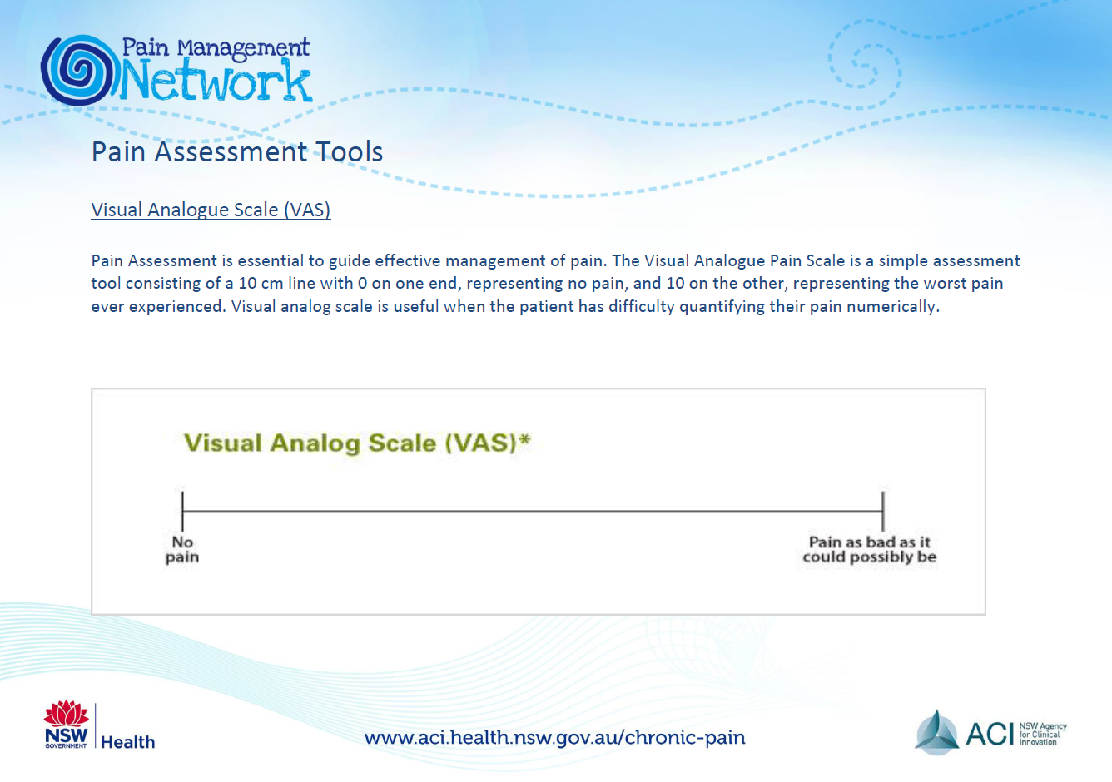
Visual analog scale
Example of visual analog scale
Notes:
This is an example of the visual analog scale.

Slide 14
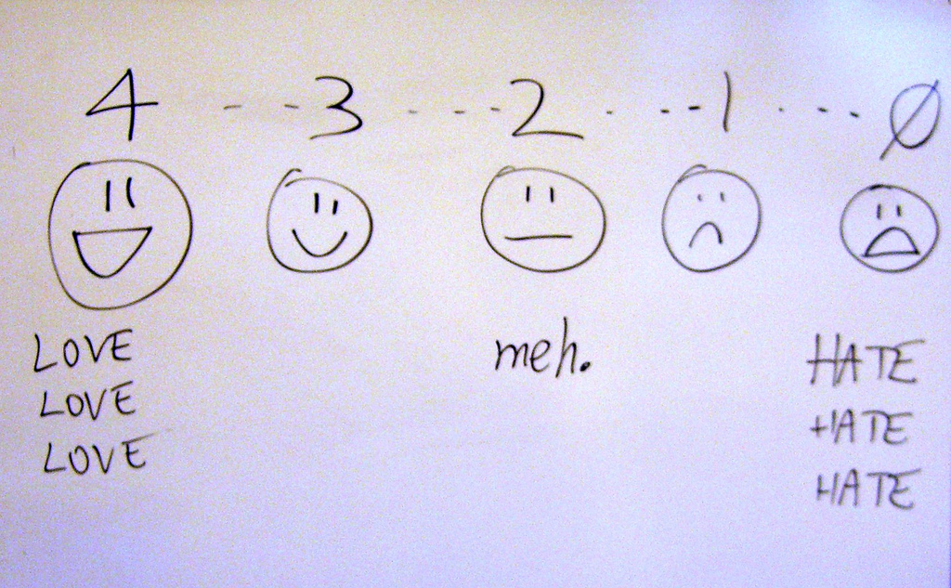
Likert scale
Humorous and drawn image of a Likert scale
Notes:
This is an example of Likert scale.
https://www.flickr.com/photos/billsophoto/4175299981

Slide 15
Likert response options
Number of points
Larger is better? worse? than smaller
Even is better? worse? than odd
Anchors
Not applicable, Don’t know
Reverse scaling
Notes:
There are a large number of ways to present a ordinal scale, and very little consensus in the research community about which approach is best. It, very likely, will depend on the context of your particular research setting. Here are some of the things that people argue about.
You have to have more than two options for an ordinal scale, or it reduces to a binary scale. So you might see three choices, or as many as ten. More than ten is very rare.
The most common number is five and the two most common alternatives are four and seven. But the two biggest debates are small versus large and odd versus even.
Is a large number of choices better or worse than a small number of choices? Some people think that too many choices will confuse you. Others think that more choices are better because they allow you the freedom to make subtle, but important distinctions. Others will argue that a larger number of choices will make it easier to analyze, because you can get closer to a bell shaped curve with a larger number of responses. This can backfire, though. With too many choices, people may gravitate towards a few favorite values leading to dips in frequencies at the unpopular values.
Is there a reason to choose even versus odd numbers. An odd number of choices always has a middle value (3 for a five point scale, for example) that represents neutral, or neither agree nor disagree. Some researchers hate this, and think that a neutral response is too easy to select thoughtlessly. An even number of values forces you to commit, even if only slightly, to the agree side or the disagree side.
Anchors are the words that are atached to the ordinal values. In the most common form, you are asked to read a statement and choose among Strongly disagree, disagree, neutral, agree, and strongly agree. For a six point scale this would be modified to Strongly disagree, Disagree, Slightly disagree, Slightly agree, Agree, Strongly agree.
You can choose other options, though. So you might ask about frequency. The choices could be Very frequently, Frequently, Occasionally, Rarely. Another choice would be Never, Rarely, Sometimes, Often. You could refer to a calendar with responses like Every day, Two or three times a week, Once a week, Less than once a week.
If you are measuring satisfaction, you might choose Very satisfied, Satisfied, Dissatisfied, Very dissatisfied.
If you are measuring quality, you might choose Excellent, Very good, Good, Fair, Poor.
If you are asking how important something is, you might choose Very important, Important, Moderately important, Slightly important, Not at all important.
You might ask people to choose between two moods, such as Very happy, Happy, Neither happy nor unhappy, Unhappy, Very unhappy.
For moods, sometimes researchers will just place anchors at each end and leave the middle responses blank. This is often done with a range of polar adjectives like rude/courteous, calm/excited, violent/gentle, silly/serious. Choosing between two polar adjectives is often called a semantic differential scale.
Sometimes, you might want to leave a response blank because it is not applicable, or you don’t know. Both of these responses are different from the neutral option in a five point Likert scale, but if you aren’t give a not applicable or don’t know option, you might choose the neutral option as the best alternative.
Reverse scaling is the inclusion of questions where a positive result is sometimes scored as a high number and sometimes scored as a low number. This is done sometimes to insure that people read each question carefully and don’t just choose the same option thoughtlessly down the list.

Slide 16
Nominal responses
Pick one of the following
Assumes mutually exclusive
Pick all that apply
Allows for overlap
Code as multiple binaries
Code for “other”
Partial open ended
Code for “Prefer not to answer”
Notes:
For nominal categories, you have two approaches. The first approach is to ask your research subjects to choose only one response from the list. This assumes that there is only one obvious choice in the list for anyone and everyone. For the marital status question, it seems obvious enough. The choices are single, married, divorced, or widowed. These seem to be mutually exclusive, but what about someone who was married, widowed, remarried, and then divorced. This isn’t all that common, so maybe you don’t have to worry about it.
The nominal category that has gotten a lot of attention recently is race. There is a vocal lobby in the community to allow someone to select more than one category. You could include a bi-racial category, perhaps. Or you could let everyone select multiple racial categories.
There’s really no correct answer. A lot depends on the context.
The standard way to code multiple response variables is to include an indicator for each category. I will talk about that in more detail later.

Slide 17
Question order
Sensitive questions last
Broad categories
Income
Avoid leading up to a question

Slide 18
Practical advice
Don’t ask for what you don’t need
Intrusive and personal questions
More data than you have time to analyze
Make your questionnaire easy for data entry
Pilot test your questionnaire
Notes:
I recall a survey I was asked to fill out. It was on perceptions about web sites or something other quite technical. They asked the standard questions about demographics: age, gender, race/ethnicity. Then there was a question about sexual identity. It listed heterosexual. It listed homosexual. It listed bi-sexual. It listed transexual. It went on and on and on. Every choice for LGBTQIA and then some. Now I have a fairly open mind when it comes to sexuality, and there are times when you really do need to know this level of detail. A study of sexually transmitted diseases might need to understand sexuality at such a fine level of detail. But a tech questionnaire about web sites? I suspect that the person who wrote this survey had a close friend who was LGBT and wanted to be sure that his survey was sensitive to the variety of sexualities that too often are disparaged or ignored.
I make it a habit of asking people, after they are done defending their thesis or dissertation what they would have done differently if they had to do it all over again. A common response is that they would not have collected so much data. They never got around to analyzing even half of it. Now, it may seem like sacrilege for a statistician to agree with this, but I do think it is a bad idea to bite off more than you can chew, so to speak. If nothing else, a shorter questionnaire would have a higher compliance rate and better quality responses.
If you are using a paper questionnaire, lay out the questionnaire in a manner that makes it easy for data entry. This means lining up things nicely so the numbers are consistently in the same location (e.g., flush with the right margin). This sort of design will also minimize problems with people accidentally skipping some items.
You should also run a pilot test on your questionnaire. Last week, I talked about response process validation. Those steps work very well for pre-testing a questionnaire. Give the questionnaire to a small sample of your patients and watch as they fill it out. Get them to talk out loud about what they are thinking.
After the questionnaires are filled out, look for improper or unexpected responses. If people are filling out a response halfway between 3 and 4 on a five point Likert scale, then maybe you would be better off with a seven point Likert scale. If people are circling two or more responses, even though you tell them to select only one, then maybe you should restructure your questionnaire to accommodate multiple responses. If the fill in the blank responses are not providing you the correct data, changing how you ask for that information.
Do the subjects in your pilot study make simple mistakes like failing to check the back side of the survey? Do they refuse to answer certain questions because of their sensitive nature? Do they tend to mindlessly choose the same middle answer throughout a series of Likert scale questions. Do they always choose the rightmost extreme, even on questions that are reverse scaled?
During your pilot, see if you can get some data on how long it takes on average to fill out the questionnaire. This could be placed in the cover letter for the questionnaire or in the consent form.
Also get an estimate on how much labor is needed to distribute and recollect all the questionnaires. See how many people need a reminder notice (or two reminders) to return their questionnaires. This sort of information during a pilot study will help you plan the main study more effectively.

Slide 19
Take a second break
What have we learned
Questionnaires
Question types
What is coming up next
Existing data source
Advantages of different data collection approaches

Slide 20
Existing data sources
Re-analysis of published data
Protect confidentiality
Give appropriate acknowledgement or co-authorship
Curated databases
Contractual limitations
Sample weights
Web scraping
Respect limits on volume and speed of download
Protect copyrights
Notes:
Our department is big on secondary data analysis. This is the re-use of existing data sets. These come from a variety of sources, but you must always respect the limits that the original researchers place on their data.
If you are taking data from an existing research publication (or, in the case of meta-analysis, from multiple existing research publications), find out what sort of acknowledgement is appropriate. In some circumstances, you may feel obligated to offer co-authorship to the original researchers. If this is the case, get an agreement in writing before you start any work. It is a bit easier if the researchers have included a link to the raw data in their publication, but still be careful to read any restrictions that they may have placed on the original data.
If the data that you are getting includes Protected Health Information (PHI), there are important regulations that you must follow under the Health Insurance Portability and Accountability Act. Because you are working with PHI, you need to get approval from your local IRB even though the original authors got IRB approval at their site.
If the authors have made their data set available for free download, your life is a bit easier. There is no PHI in a publicly available data set, or if there were, the person who would get in trouble for this would be the original authors. You have to promise not to take the disparite pieces of information that by themselves are innocuous enogh, but which in aggregate might allow you to figure out the identity of some of the people in the sample.
Various groups will collect data not for their own benefit, but rather to let others publish interesting things. This might be through a government program or through a charitable foundation. These data sets are carefully curated and have excellent documentation. The people behind these data sets are very eager to help. They see your publications as being one of the strongest rationales for what they are doing. They want you to be successful.
Read the documentation carefully, including the limits on how you can use this data. Even though the data has been anonymized, you will be asked to promise that you will not try to use certain crosstabulations that might identify individual respondents.
Many of these data sets have sample weights associated with them. The sample weights help you properly calibrate your results to nationwide totals, or they help you properly account for oversampling of minority groups. Some of these data sets use clustering and stratification to reduce costs and improve the coverage and quality of their data. If you are using data that requires sample weights, failure to choose the appropriate analysis will produce invalid results.
A new source of data is stored on the Internet, and getting this data often requires specialized tools, web scrapers. The data that you get from web scraping is free (other than your time and labor) and will almost always be exempt from IRB approval. Some sites will have policies on web scraping, limiting either the amount of data you can take, the speed at which you can take it, or both. These limits are needed to insure that others who need this data for a variety of reasons won’t be crowded out by web scraping robots. Some of the information that you get through web scraping may also be protected by copyright law.

Slide 21
Advantages of focus groups
Faster than separate interviews
Participants build each others comments

Slide 22
Advantages of interviews
On-the-spot fixes
Increased participation rate

Slide 23
Advantages of a questionnaire
Less labor
No interviewer bias

Slide 24
Advantages of existing data
Fast

Slide 25
Take a third break
What have you learned
Collection from existing data sources
Advantage of different data collection methods
What is coming next
Data quality

Slide 26
Pilot testing
Clarity of items
Content
“Whether your items cover all aspects of the domain you intend to measure and whether they are in appropriate proportions relative to that domain.”
page 258

Slide 27
Data Collection Techniques
Process of developing a survey
List of measures/variables
What’s already available?
Put the pieces together
Test and revise as needed
Final check – do you really need all of the items?
Analysis of survey data
Notes:
Flows well and is clear.
Get some real test runs with people who have seen it for the first time. Do you really need all of these items?
[[Example of sexual preferences in survey on Internet usage.]]
http://www.pmean.com/10/BadSurvey.html

Slide 28
Coding
Mutually exclusive
Multiple response
“Other” responses
Use number codes for categorical data
Missing codes
Never use blanks for missing (book is wrong)
-1, 99
Multiple codes for multiple reasons
Dummy coding
0/1 for absence/presence
Reverse coding
High is always positive
Tabular format
No more than one piece of information
Double entry coding
Standard coding for race/ethnicity

Slide 29
Variable names
Not too short, not too long
Word delimiters
No spaces, symbols
Example for Mother’s age
Bad choices
mom age
mom-age
momage
Good choices
mom.age
mom_age
MomAge

Slide 30
Codebook
Also known as data dictionary

Slide 31
Quality checks
Minimum and maximum checks
Out of range
Zero variation
Missing value count
List five five rows, last five rows
Correlations

Slide 32
Data reduction
Create composite scores
Check Cronbach’s alpha
Examine leaving out single items
Factor analysis
Supplanted by Structural Equations Modeling

Slide 33
Data transformations
Ideal - selected a priori
Sometimes based on precedent
Sometimes motivated by theory
Sometimes based on empirical findings

Slide 34
Additional topics
Pilot studies
Questionnaires. http://www.pmean.com/02/questionnaire.html

Slide 35
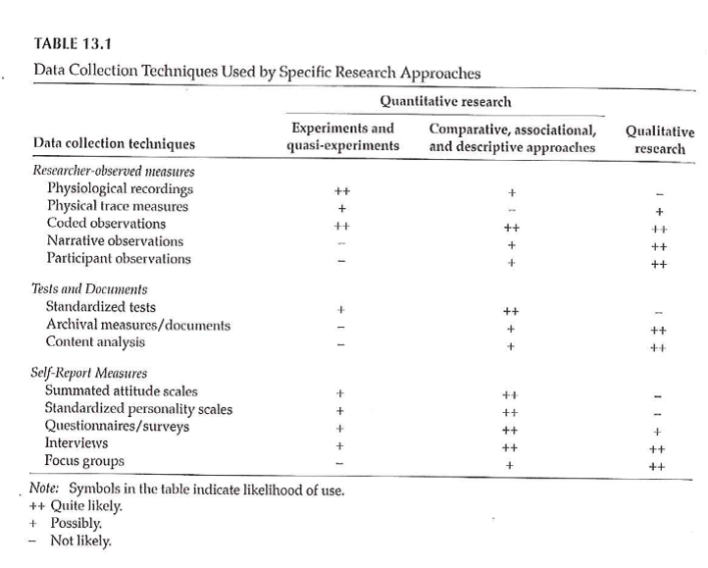
Data Collection Techniques
Notes:
Table 13.1 is useful in terms of the various things that we will touch on. It classifies by the two types of quantitative research and by qualitative research. Organized by the potential amount of patient filtering. The ones at the top should have less participant filtering. Also note that the symbols are not hard and fast rules, but represent the likelihood.

Slide 36
Data Collection Techniques
Standardized vs Investigator-Developed Instruments
Development and Use
Evidence to support investigator-developed instruments
Notes:
There is a lot of work in the development of standardized instruments, manual and documentaiton, normative values, apply to a broad area. Investigator developed instruments focus on a more specialized area, but you still need to supply information on validity and reliability.
Whenever possible use instruments already in use. You can find these in places like PROQOLID. This originally started as quality of life measurements, but has expanded. NIH compilation of patient reported outcome measures (PROMIS). NIH wants the research community to use common measures to allow easier compilation of studies in a meta-analysis.

Slide 37
Data Collection Techniques
Researcher-Observed Measures
Naturalness of the setting
Observer “participation”
Amount of detail
Breadth of coverage
Notes:
The focus is on direct observation. The more natural the setting, the less control you have. This might hurt the internal validity of the study. It is a trade-off.
How much does the observer participate. In interviews and focus groups, there is a very clear high level of participation. On the other extreme, observation in public places might not have any knowledge of their participation. In the middle are studies where participants know they are being observed, but this knowledge may fade into the background.

Slide 38
Data Collection Techniques
Tests and Documents
Standardized tests
Norm referenced test
Criterion referenced test
Achievement tests
Performance and Authentic assessments
Aptitude tests
Documents
Content analysis
Notes:
Norm scores allow you to compare to other scores (historical comparisons). These tests are very objective, but there is some subjectivity, perhaps, in their interpretation.
Measuring actual performance (ecologic validity). Tries to be very relevant to the setting.
Use existing documents. Existing records might have a higher level of accuracy but there is no gauarantee. Time is shorter because the documents already exist. Data extraction takes time. Do you need consent from the people associated with these documents.
Data abstraction is tedious, but the newer systems like i2b2 allow you to get the information more directly.
Content analysis is a more qualitative review. It gives you a lot of valuable information that a quantitative approach might miss.

Slide 39
Data Collection Techniques
Self-Report Measures
Standardized Personality Inventories
Attitudes / Beliefs scales
Likert scale
Semantic differential scale
Questionnaires
How delivered / administered
Item types
Interviews
Focus groups
Notes:
Personality inventories: the validity is dependent on an individual’s self-awareness.
Attitudes and beliefs done for a variety of purposes. A “representative sample of all possible opinions or attitudes about a particularl subject.” That’s why measurement experts cringe when you ask a single question. You need a multiple set of items to get at how people feel.
The Likert scale is very popular. You may not see the semantic difference scale, but examples will follow.
Delivery by mail or Internet. There are pros and cons to all formats. Item types could include open-ended, partial (responses plus other), and close ended responses.

Slide 40
Descriptive Research
Surveys
Methods
Interview
Questionnaires
Design of surveys
Research question
Review of existing instruments
Process of designing survey
Notes:
Interview allows you to probe for comments. Video as well as audio is now available. It takes time and training. Concerns about anonymity with an interview.
Questionnaires are self-administered. Return rates are a concern. When sent out blindly, you can get low return rates, which hurts the generalizability of the study. There is potential for misunderstanding and people may get into a routine response and not provide as good quality of response.
Design the survey to address your research question. Thing about the pieces and the order.

Slide 41
Data Collection Techniques
Surveys
Survey question format –
Open-ended
Close-ended
Wording of questions
Scales
Scale of measurement
Response options
Notes:
Even as simple as something like age, you can ask it in an open-ended format that allows you to categorize any way you like or even to forgo categorization.
Wording is important. Simplicity and reading level. Use standardized scales whenever you can.
Double-barreled questions. [[Ask option about supervisors and managers]]
How many times questions, think about the time frame (over the past 24 hours, past week, past month). Shorter time frames better recall, but subject to more external variations.
Building a level of trust. Don’t ask people to admit to “bad behavior”. Think of it from the perspective of the person providing the information.
[[Income: actual versus categories]]

Slide 42
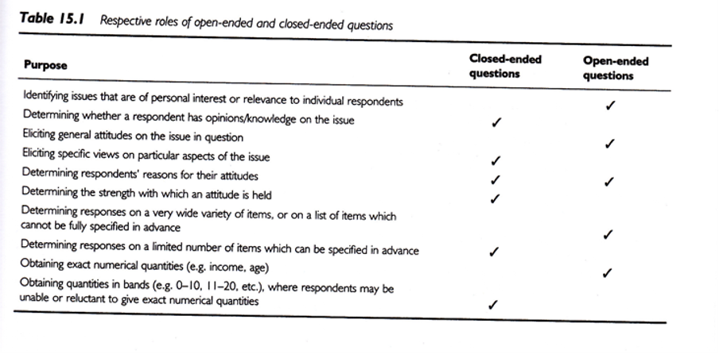
Data Collection Techniques
Notes:
Open-ended vs Close-ended
Respective roles of open or close ended format. This is a nice guide.
.footnote[Sim & Wright, 2002]

Slide 43
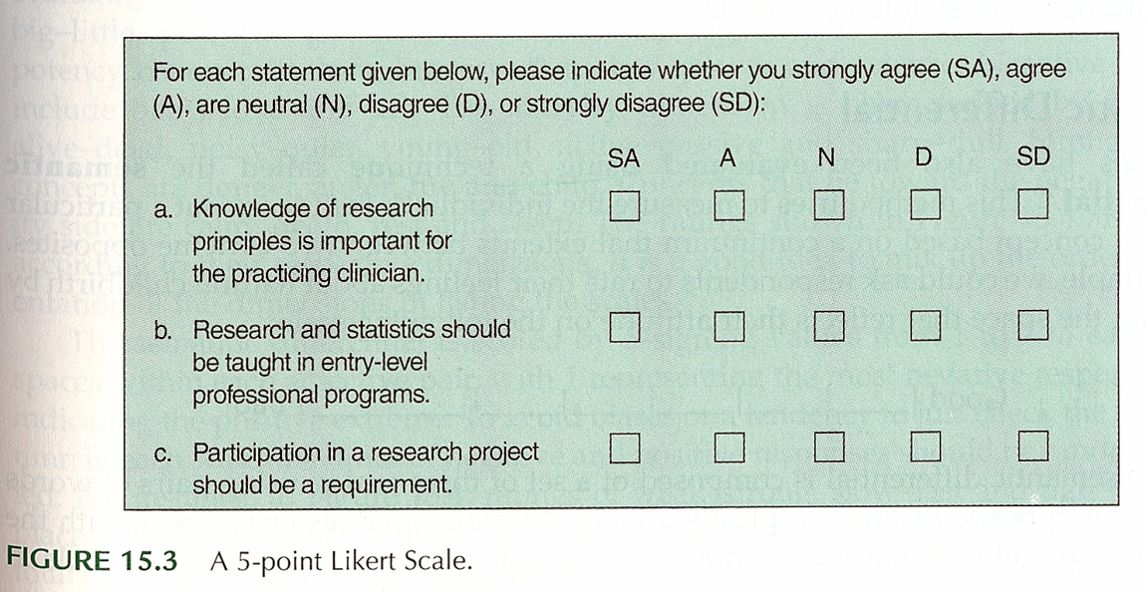
Data Collection Techniques
Notes:
Surveys – Response Options
Likert
.footnote[Portney & Watkins, 2009]
Example of five points (SD, D, N, A, SA)

Slide 44
Data Collection Techniques
..
Notes:
Everyone uses the term Likert with a hard-i, but the persons who developed this scale used a soft-i.
All items contributing to a total.
Some debate about the number of categories. Odd versus even. Even forces an opinion. Also a debate over a large versus a small number of items.
Do you want to reverse code some items. It could help keep the participants alert and thingking This may end up confusing. [[13 questions, but question 8, first question on the bakc page, was the only reverse coding.]]
Surveys – Response Options
Likert
.footnote[Sim & Wright, 2002]
Figure 15.8 is a different version of a five point scale.
Commercial plug for REDCap. Entry on a tablet. Coding is done on the back-end.

Slide 45
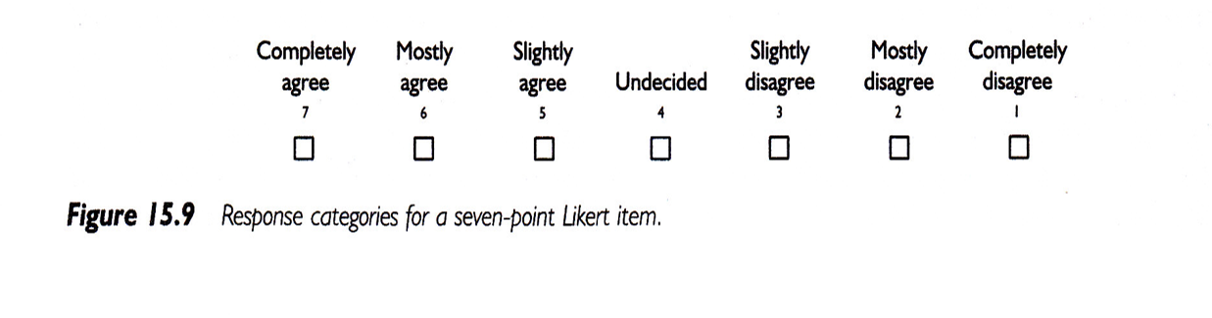
Data Collection Techniques
Notes:
Surveys – Response Options
Likert
.footnote[Sim & Wright, 2002]
Figure 15.9 shows a seven point response.
IRB insistence on a “Prefer Not to Answer” response. Contrast this to a “Neutral” option.

Slide 46
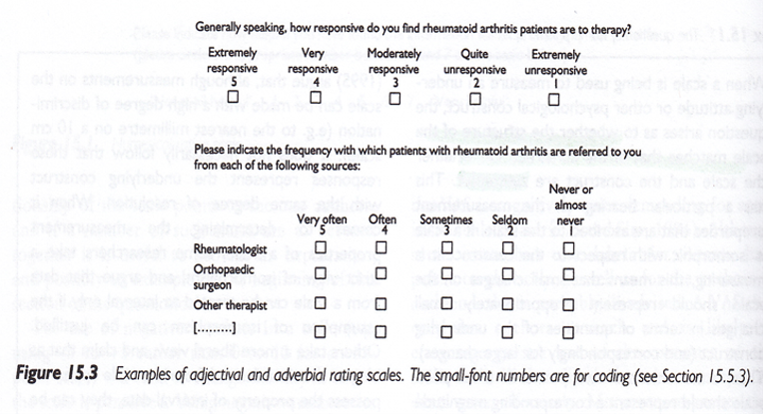
Data Collection Techniques
Notes:
Surveys – Response Options
.footnote[Sim & Wright, 2002]
Figure 15.3
These scales seem backwards to Mary. You don’t necessarily need to include the numbers are on the form. They can be added on the back end.

Slide 47
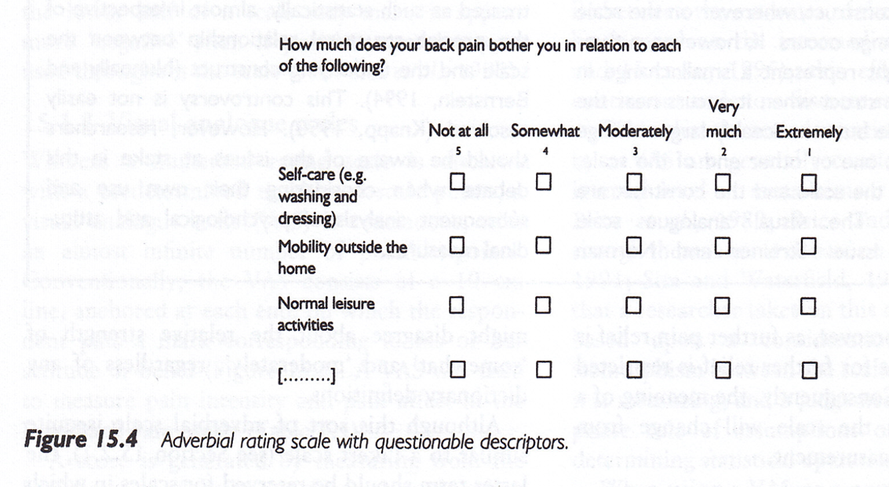
Data Collection Techniques
Notes:
Surveys – Response Options
Figure 15.4, Sim & Wright, 2002.
Not at all, somewhat, moderately, very much, extremely.
Note that the largest number is associated with “not at all”.
Double check that everyone agrees that somewhat is less than moderate, very much is less than extremely.

Slide 48
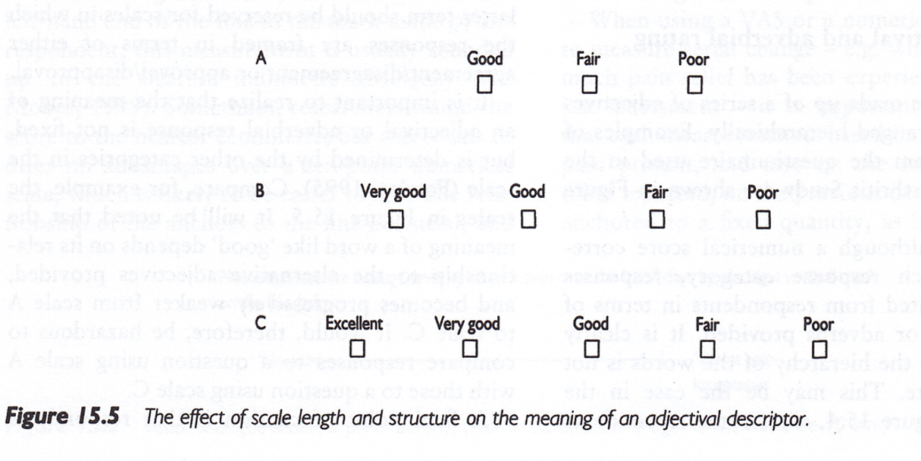
Data Collection Techniques
Notes:
Surveys – Response Options
Figure 15.5. [Sim & Wright, 2002]
Good, Fair, Poor is a three point scale. Add Very good for a four point scale. Add Excellent to get a five point scale.

Slide 49
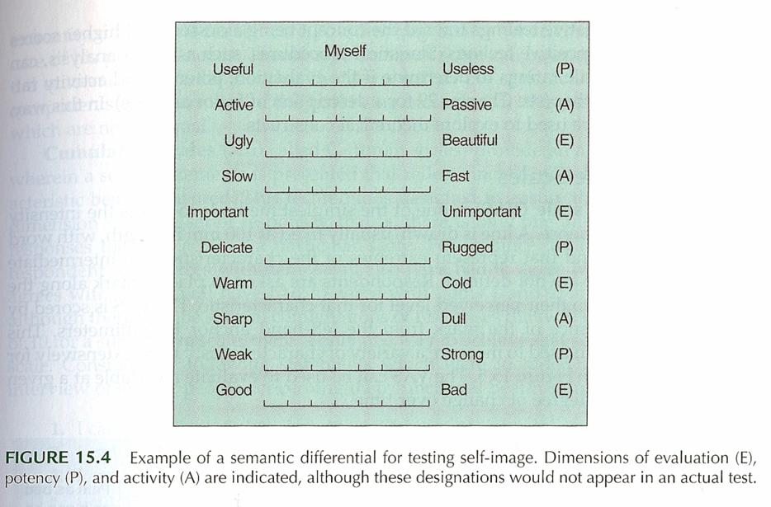
Data Collection Techniques
Notes:
Surveys – Response Options
Semantic Differential
Figure 15.4 [Portney & Watkins, 2009]
This is an example of a semantic differential. Seven point scale. Only label the extremes. Notice the reverse scaling of some items.

Slide 50
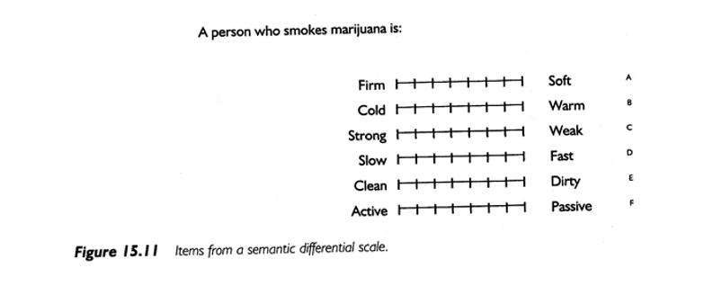
Data Collection Techniques
Notes:
Surveys – Response Options
Semantic Differential
Figure 15.11 [Portney & Watkins, 2009]
A second example of a semantic differential scale.

Slide 51
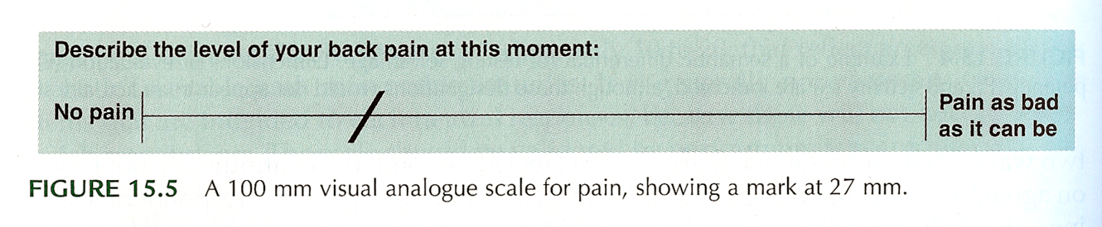
Data Collection Techniques
Notes:
Surveys – Response Options
Visual Analogue Scale (VAS)
Figure 15.5. [Portney & Watkins, 2009]
Commonly used for pain. Usually the line is 100 mm long. Gives you a number from 0 to 100, which allows you to treat this as a continuous variable.
Anchors at each extreme.
How do you handle a check mark.
This is a very labor intensive data entry task.
Note that the photocopy process can change the length of the scale (102 mm versus 100 mm).

Slide 52
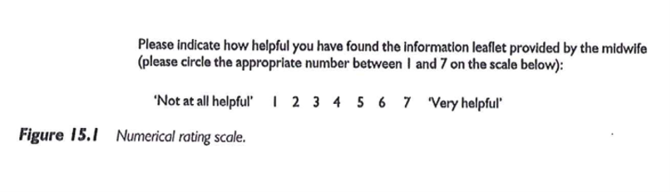
Data Collection Techniques
Notes:
Surveys – Response Options
Numerical Rating Scale
Figure 15.1 [Sim & Wright, 2002]
This scale has 7 numbers with anchors at each end.

Slide 53
Descriptive Research
Surveys
Pit-falls and words of caution
How responses are recorded
Wording of items
Literacy level
“ Loaded ” wording
Complexity of items
More than 1 “ unit ” in a single item
Clearly stated terms
Notes:
There are ways of checking the reading level of the survey. Good instructions. Branching (if “no” skip) patterns need to be laid out very clearly.

Slide 54
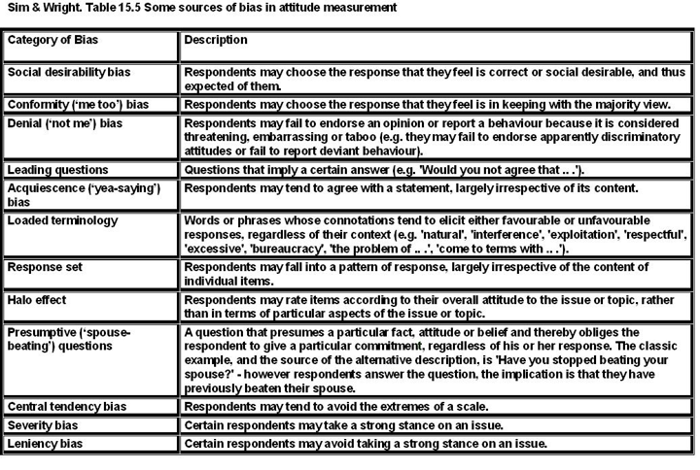
Data Collection Techniques
Notes:
Sim and Wright. Sources of bias in attitude measurement.
Social desirability, conformity, denial, acquiescence.
Leading questions, loaded terminology, presumptive (wife-beating)
Response set (stuck on the same value), or tendency to extremes.
Example of “push polling.”
“Any other comments?” http://www.biomedcentral.com/1471-2288/4/25.
http://www.pmean.com/04/DesigningQuestionnaire.html

Slide 55
Data Collection Techniques
Surveys – Example
Using a scale of 0 to 100, please indicate the percentage of time you take all the doses of your medicine?
… take all the pills in each of your doses?
… take all doses on the prescribed schedule?
… follow all special instructions …
… make sure you refill all of your medications on time?
Notes:
Medical history interview. Anti-retroviral medication, but some had no history yet, so used adherence in general. This gets tricky with multiple medications.
There’s an issue that came up when using this study, which will be discussed in the discussion board. Answer these questions yourself, and how you based your response to the second through fourth items.

Slide 56
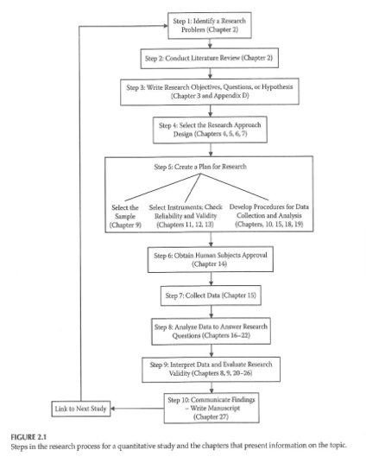
Data Collection & Coding
Notes:
Figure 2.1 from your book. This is back from Chapter 2, and keep this in mind when you are designing your data collection.

Slide 57
Data Collection & Coding
Initial Steps
Planning the study
Pilot testing
Data collection
Check for completeness if possible
Notes:
How things are working, where there is lack of clarity, how long does it take, where the systems don’t work.
Make sure that your extraction process is complete as possible for secondary data. For prospective surveys, flip through a survey upside down to see if items are all filled in. Hope that you haven’t missed a page. Electronic collection can force someone to respond before they answer the next question.
[[Ethically can’t force someone to complete a questionnaire.]]
How do you handle multiple responses.
Code the maximal detail of variables like age so you can collapse as you see fit. Make sure that you code missing or ambiguous responses consistently.
REDCap is great!
[[Double entry coding]]

Slide 58
Data Collection & Coding
Data Coding, Entry, and Checking
Guidelines
Mutually exclusive levels
Code for maximum information
Record is as complete as possible
Consistency
Data entry form
Checking entry

Slide 59
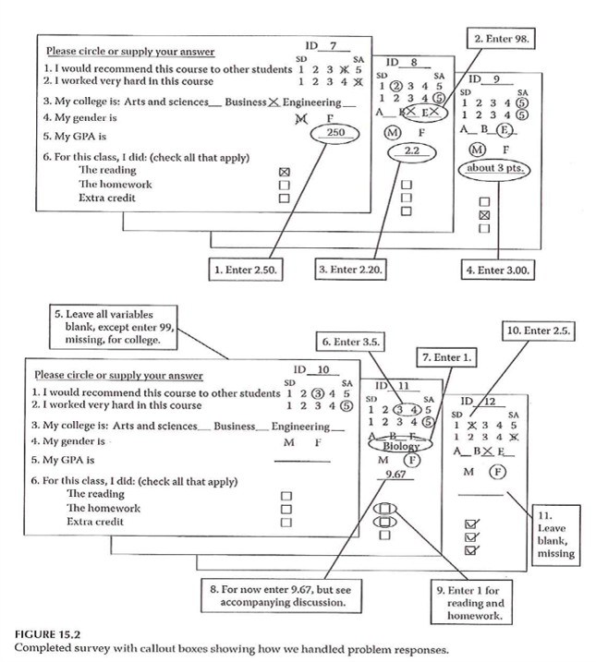
Data Collection & Coding
Notes:
Figure 15.2. Completed survey with callout boxes showing how we handled problem responses.

Slide 60
Data Collection & Coding
Data Entry into Statistical Program
Layout of data sheet
Variable names
Labeling
Variables
Values
Codebook / documentation
Notes:
[[See Intro to SAS/R material]]
By thinking about the backend process, you can sometimes fix things before you collect the data.
Mary uses Excel for documentation, but never for analysis, rarely for data entry.
Summarizes factor analysis, Cronbach’s alpha. Note whether better to have high score or better to have low score.
[[EUSpRIG site]]

Slide 61
Data Collection & Coding
Data Summation
Descriptive information
Categorical variables
Continuous variables
Data checking – part 2
Notes:
Look for inconsistent values, outliers, invalid values.
Note that certain responses on one question might lead to limits on the responses to other questions. Example, ever smoked? versus How many years?

Slide 62
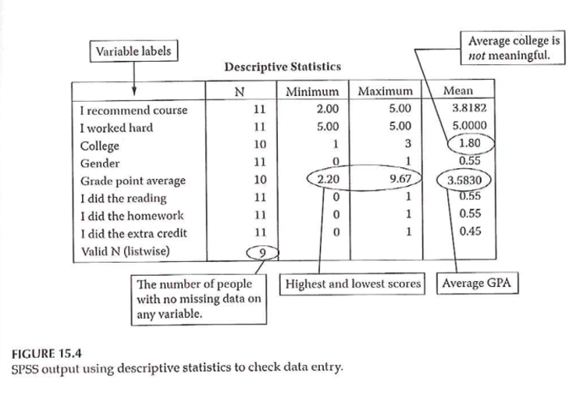
Data Collection & Coding
Notes:
Figure 15.4 shows SPSS output using descriptive statisticis to check data entry. Example of Likert scale where everyone responded 5. Note the number of responses/missing responses.
Hopefully, you’ve done such a good job planning that these issues don’t arise after the data is collected. [[Ha!]]

Slide 63
Measurement dichotomies
Standardized versus investigator developed measures
Researcher evaluation versus patient report
Field measurements versus laboratory measurements
Ecological validity
Standardized test

Slide 64
Researcher evaluations
Norm referenced tests
Criterion referenced tests
Achievement tests
Performance assessment
Authentic assessment
Aptitude tests
Projective technique
Documents

Slide 65
Self report
Standardized personality inventories
Paper and pencil
Machine scored

Slide 66
Attitude scales
Strongly disagree through strongly agree
Semantic differential scales
Evaluative (good-bad)
Potency (strong-weak)
Activity (fast-slow)

Slide 67
Questionnaires
Definitions
Survey
Questionnaire
Interview

Slide 68
Delivery
Remote administration
Mail
Internet (Survey Monkey)
Direct administration

Slide 69
Structure
Open-ended
Partially open-ended
Unordered closed response
Ordered closed response
Interviews
Telephone
Face-to-face
Focus groups

